Slide 1
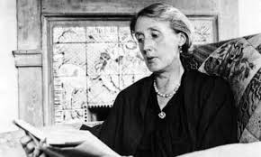
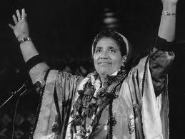
Perceived barriers to becoming research active
Virginia Woolf
Audre Lorde
action learning set

Slide 2
Unpacking key words
‘Perceived barriers’
‘Becoming’
‘Research active’
‘Women’

Slide 3
Presence and absence Historical legacies and our place in processes of historical change
‘In the early 1970s, only 1% of [UK] professors were women. Halsey & Trow’s survey of the academic profession published in 1971 reported that women academics were concentrated in the lowest ranks and made up only 10% of the academic staff.’ (Coate, ‘Feminist knowledge and the Ivory Tower: a case study’, 1999: 143)
European Research Council advanced research grants awarded to women in 2012: 12% (EU 2012)
UK professoriate, women members of: 22% average (from 7-8%)
Female academics submitted for the REF 2014: College of Social Science, 35%; Art, 50%; Science, 15%; 34% university overall

Slide 4
A challenging conjuncture
National funding for equality and diversity in the academy cut
European agenda and national campaigns to equalise & diversify
Universities
prioritising funding for STEM research

Slide 5
Gender politics and discrimination
organisational culture and politics
hegemonic masculine networks (career and recruitment)
intimidation, sexism, harassment and misogyny
gendered epistemologies and disciplines
unequal power relations
lack of recognition and respect
built environments
care
fear, insecurity, lack of confidence, ‘imposter syndrome’
‘passing’ to succeed
inexperience with career management

Slide 6
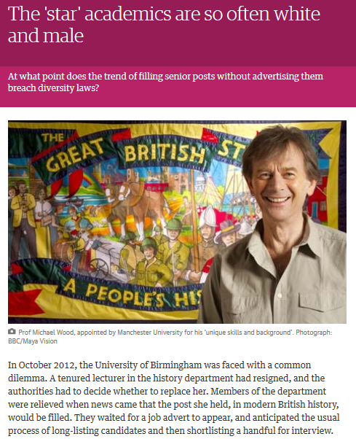
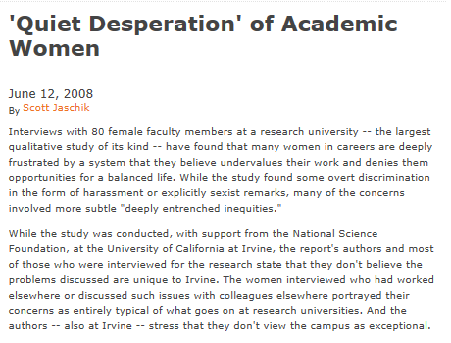

Slide 7
The action learning process
Everyone – take turns to identify something that you feel creates barriers to ‘becoming research active’ (write on paper/board)
Everyone – consider the offerings and choose one to focus on for this session (mark with pen/sticker)
Presenter – elaborate on the issue/situation/problem
Other group members – ask the presenter questions to help deepen understanding and evoke possible alternatives
Presenter – come to a working conclusion and decides how will apply in practice
Everyone – reflect on what you believe the presenter has learned and what you have learned and will consider/act on further

Slide 8
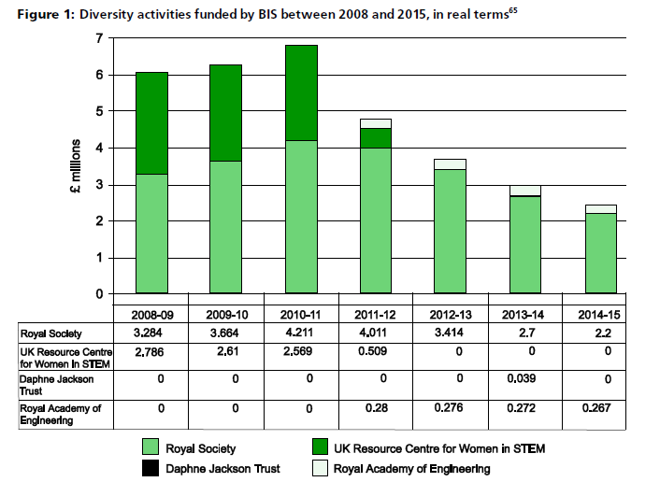
From the House of Commons Science and Technology Committee,
‘Women in Scientific Careers’, sixth report of session 2013–14.

Slide 9
Invading space?
‘What happens when women and racialized minorities take up “privileged” positions which have not been “reserved” for them, for which they are not, in short, the somatic norm? What are the terms of coexistence? This is an encounter that causes disruption, necessitates negotiation and invites complicity.’
Nirmal Puwar, Space Invaders: Race, Gender and Bodies Out of Place, 2004

